Slide 1
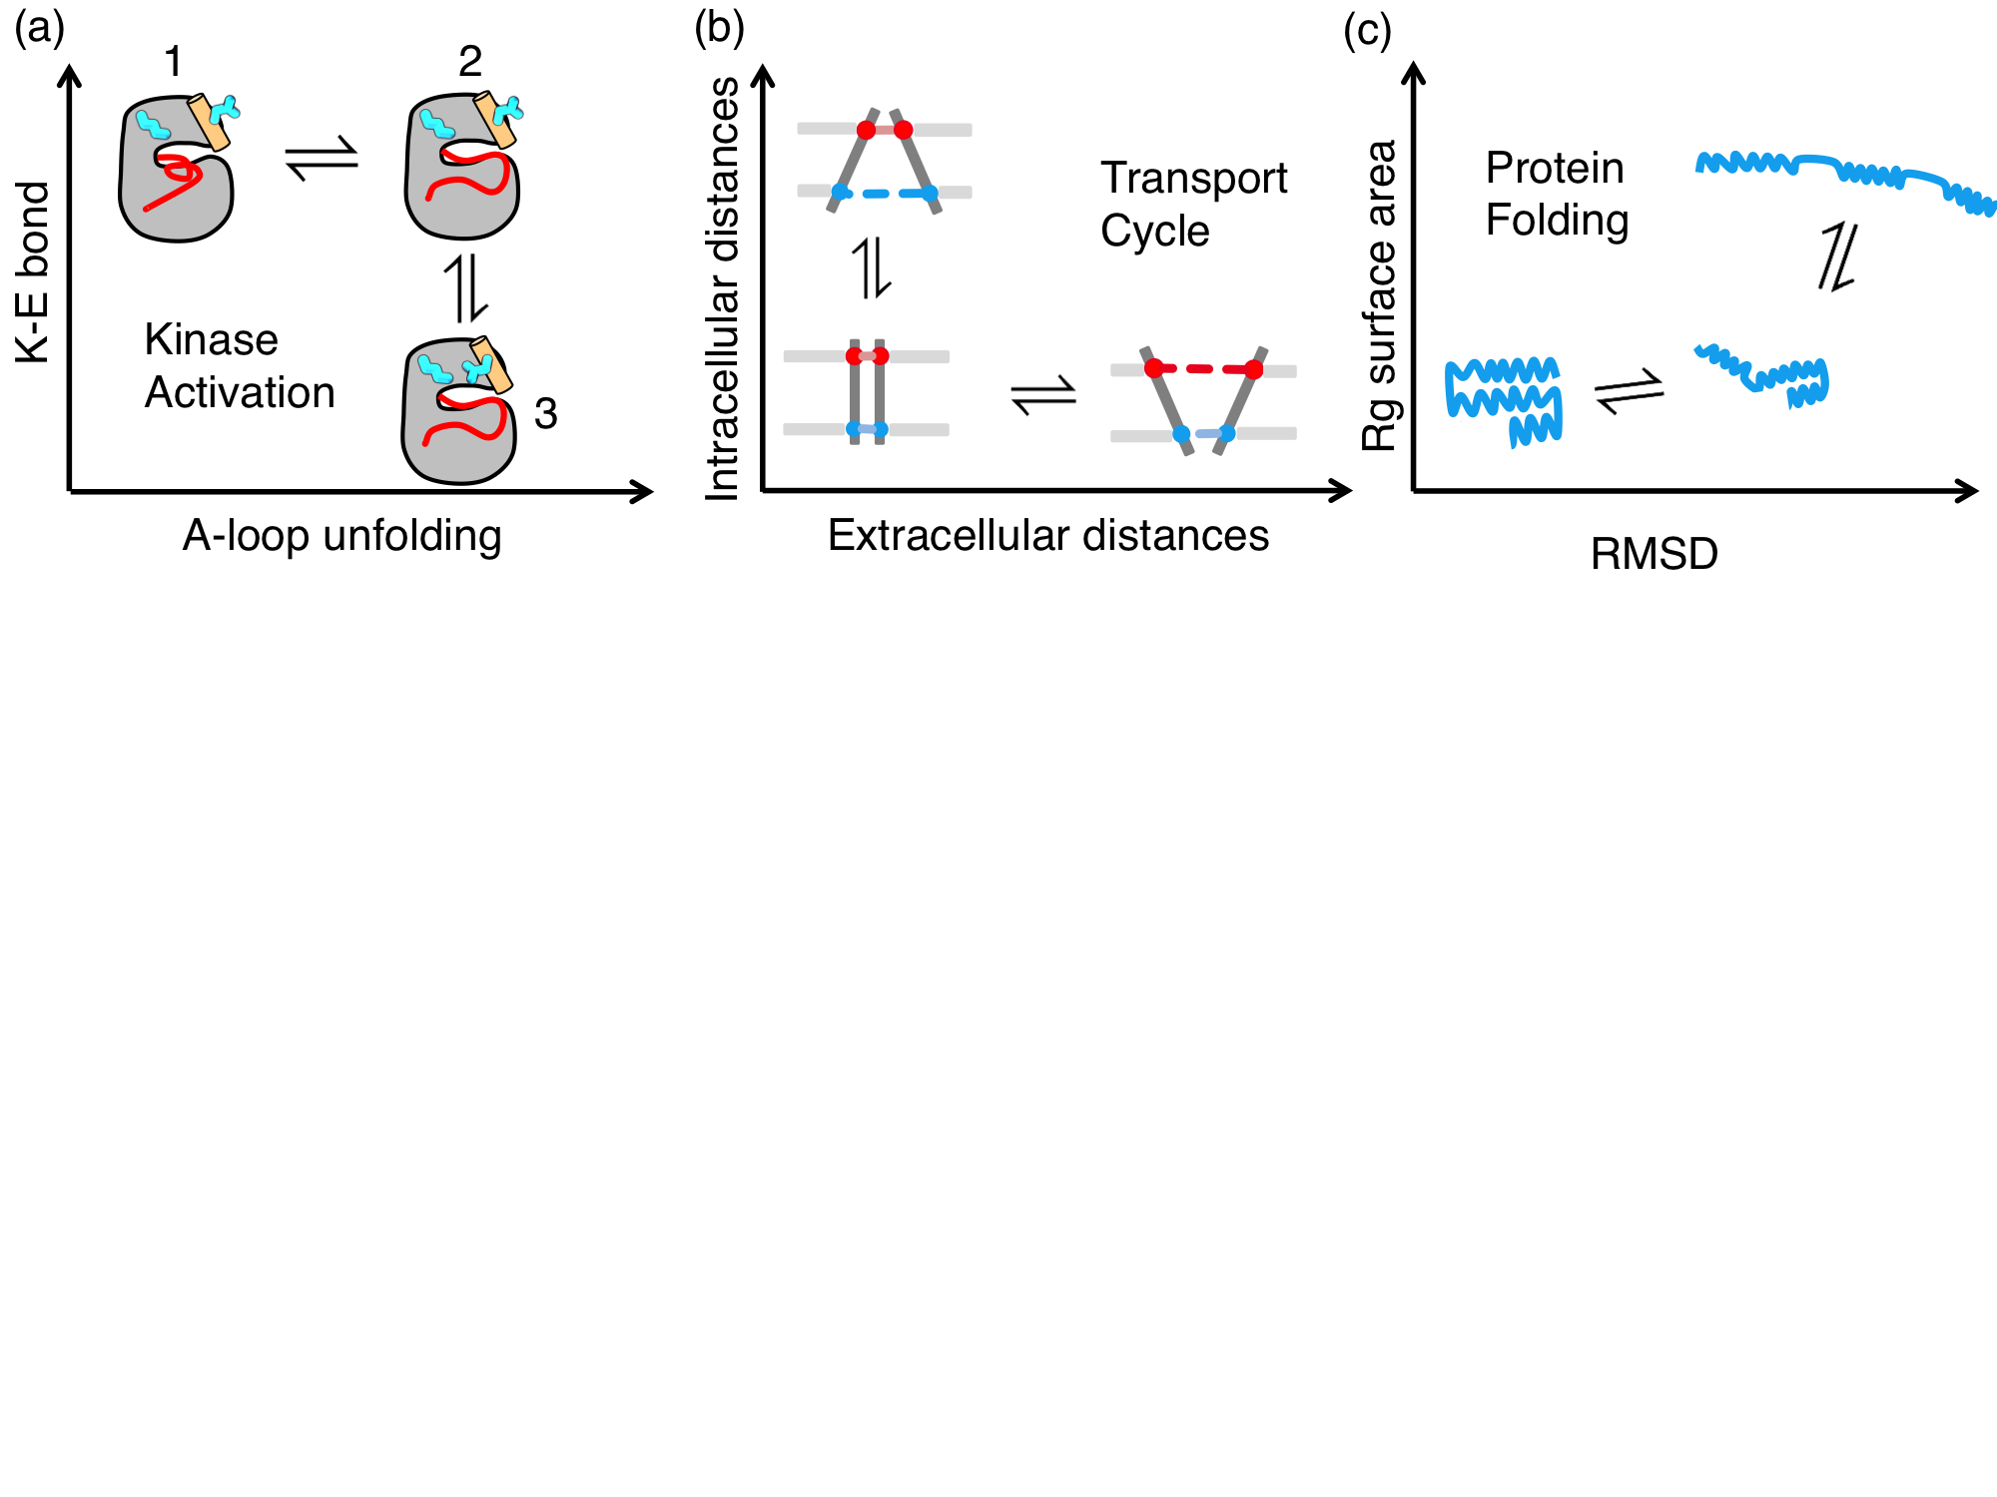
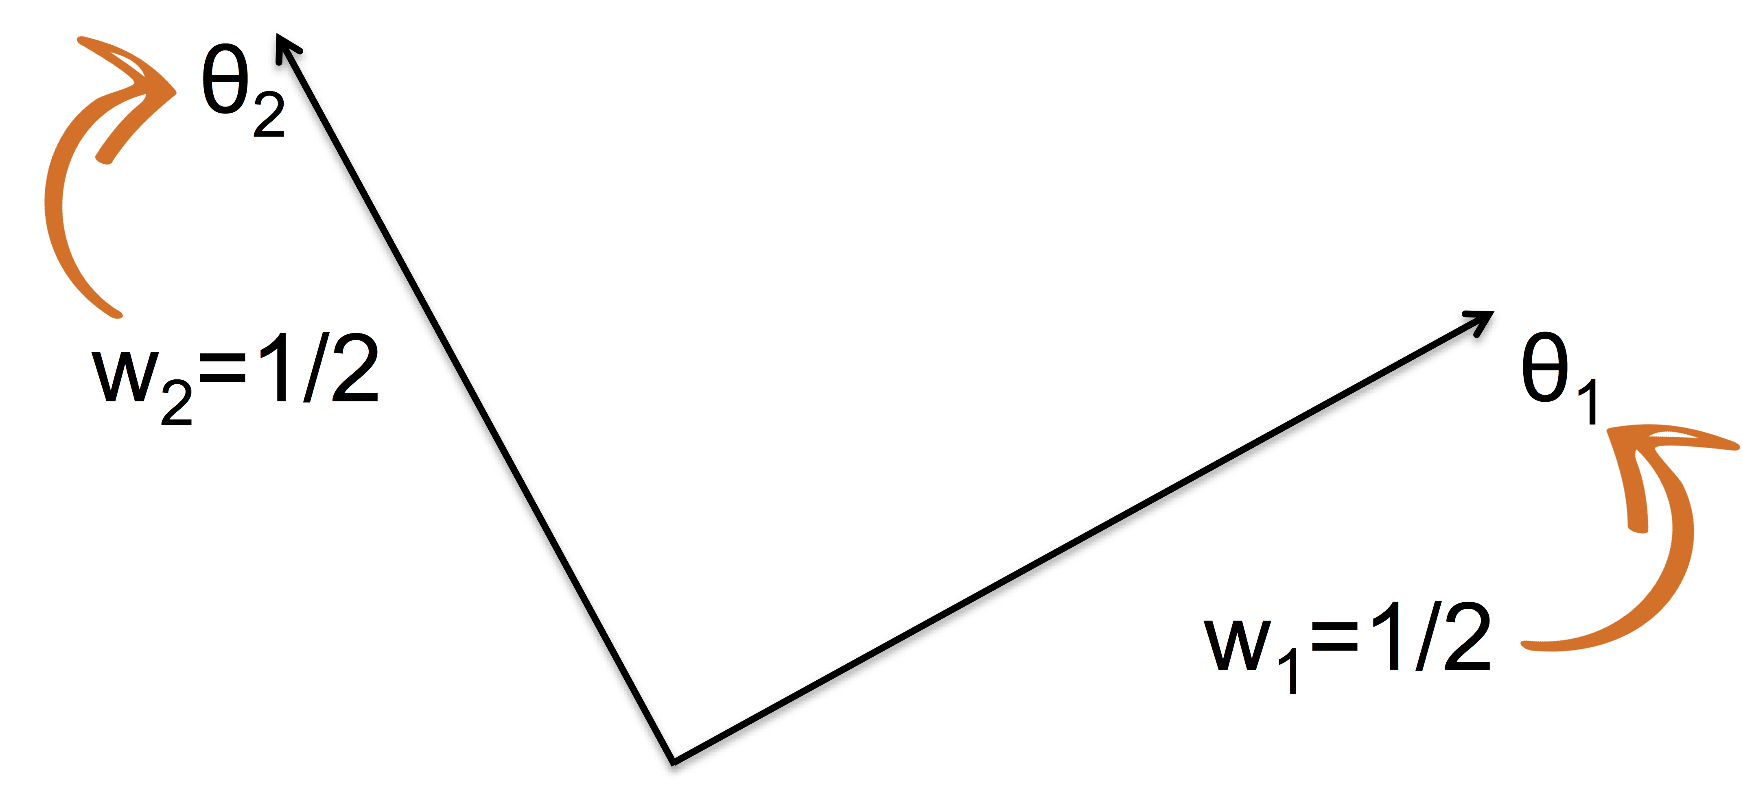
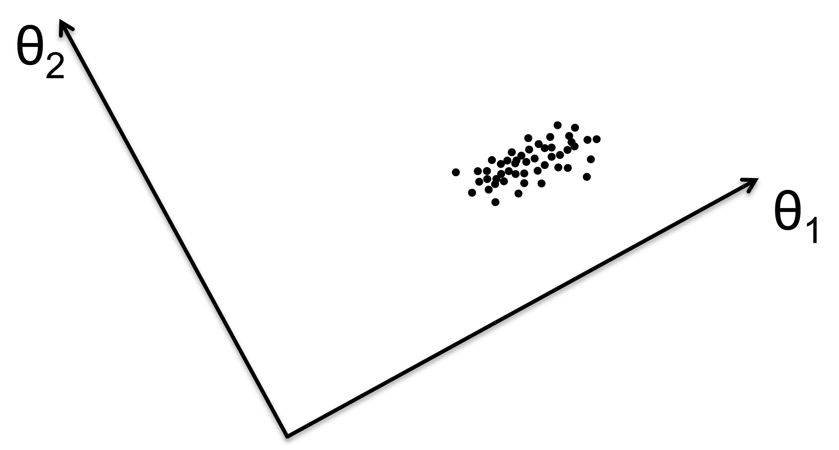
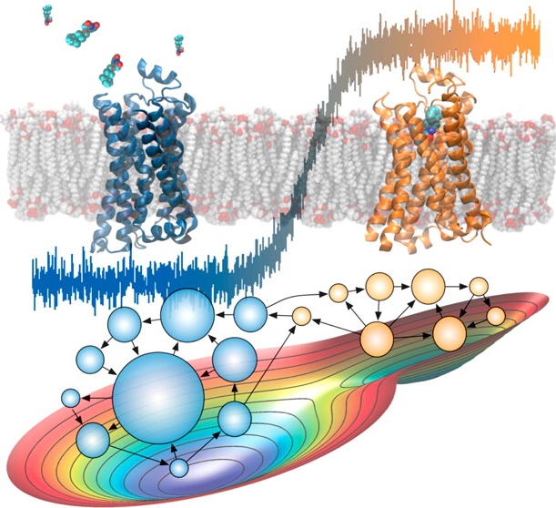
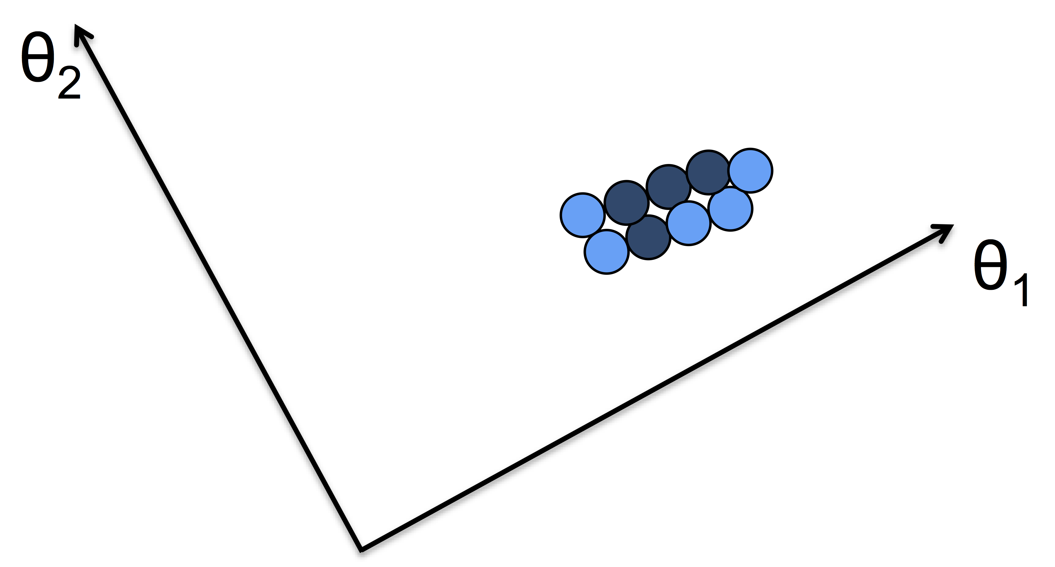
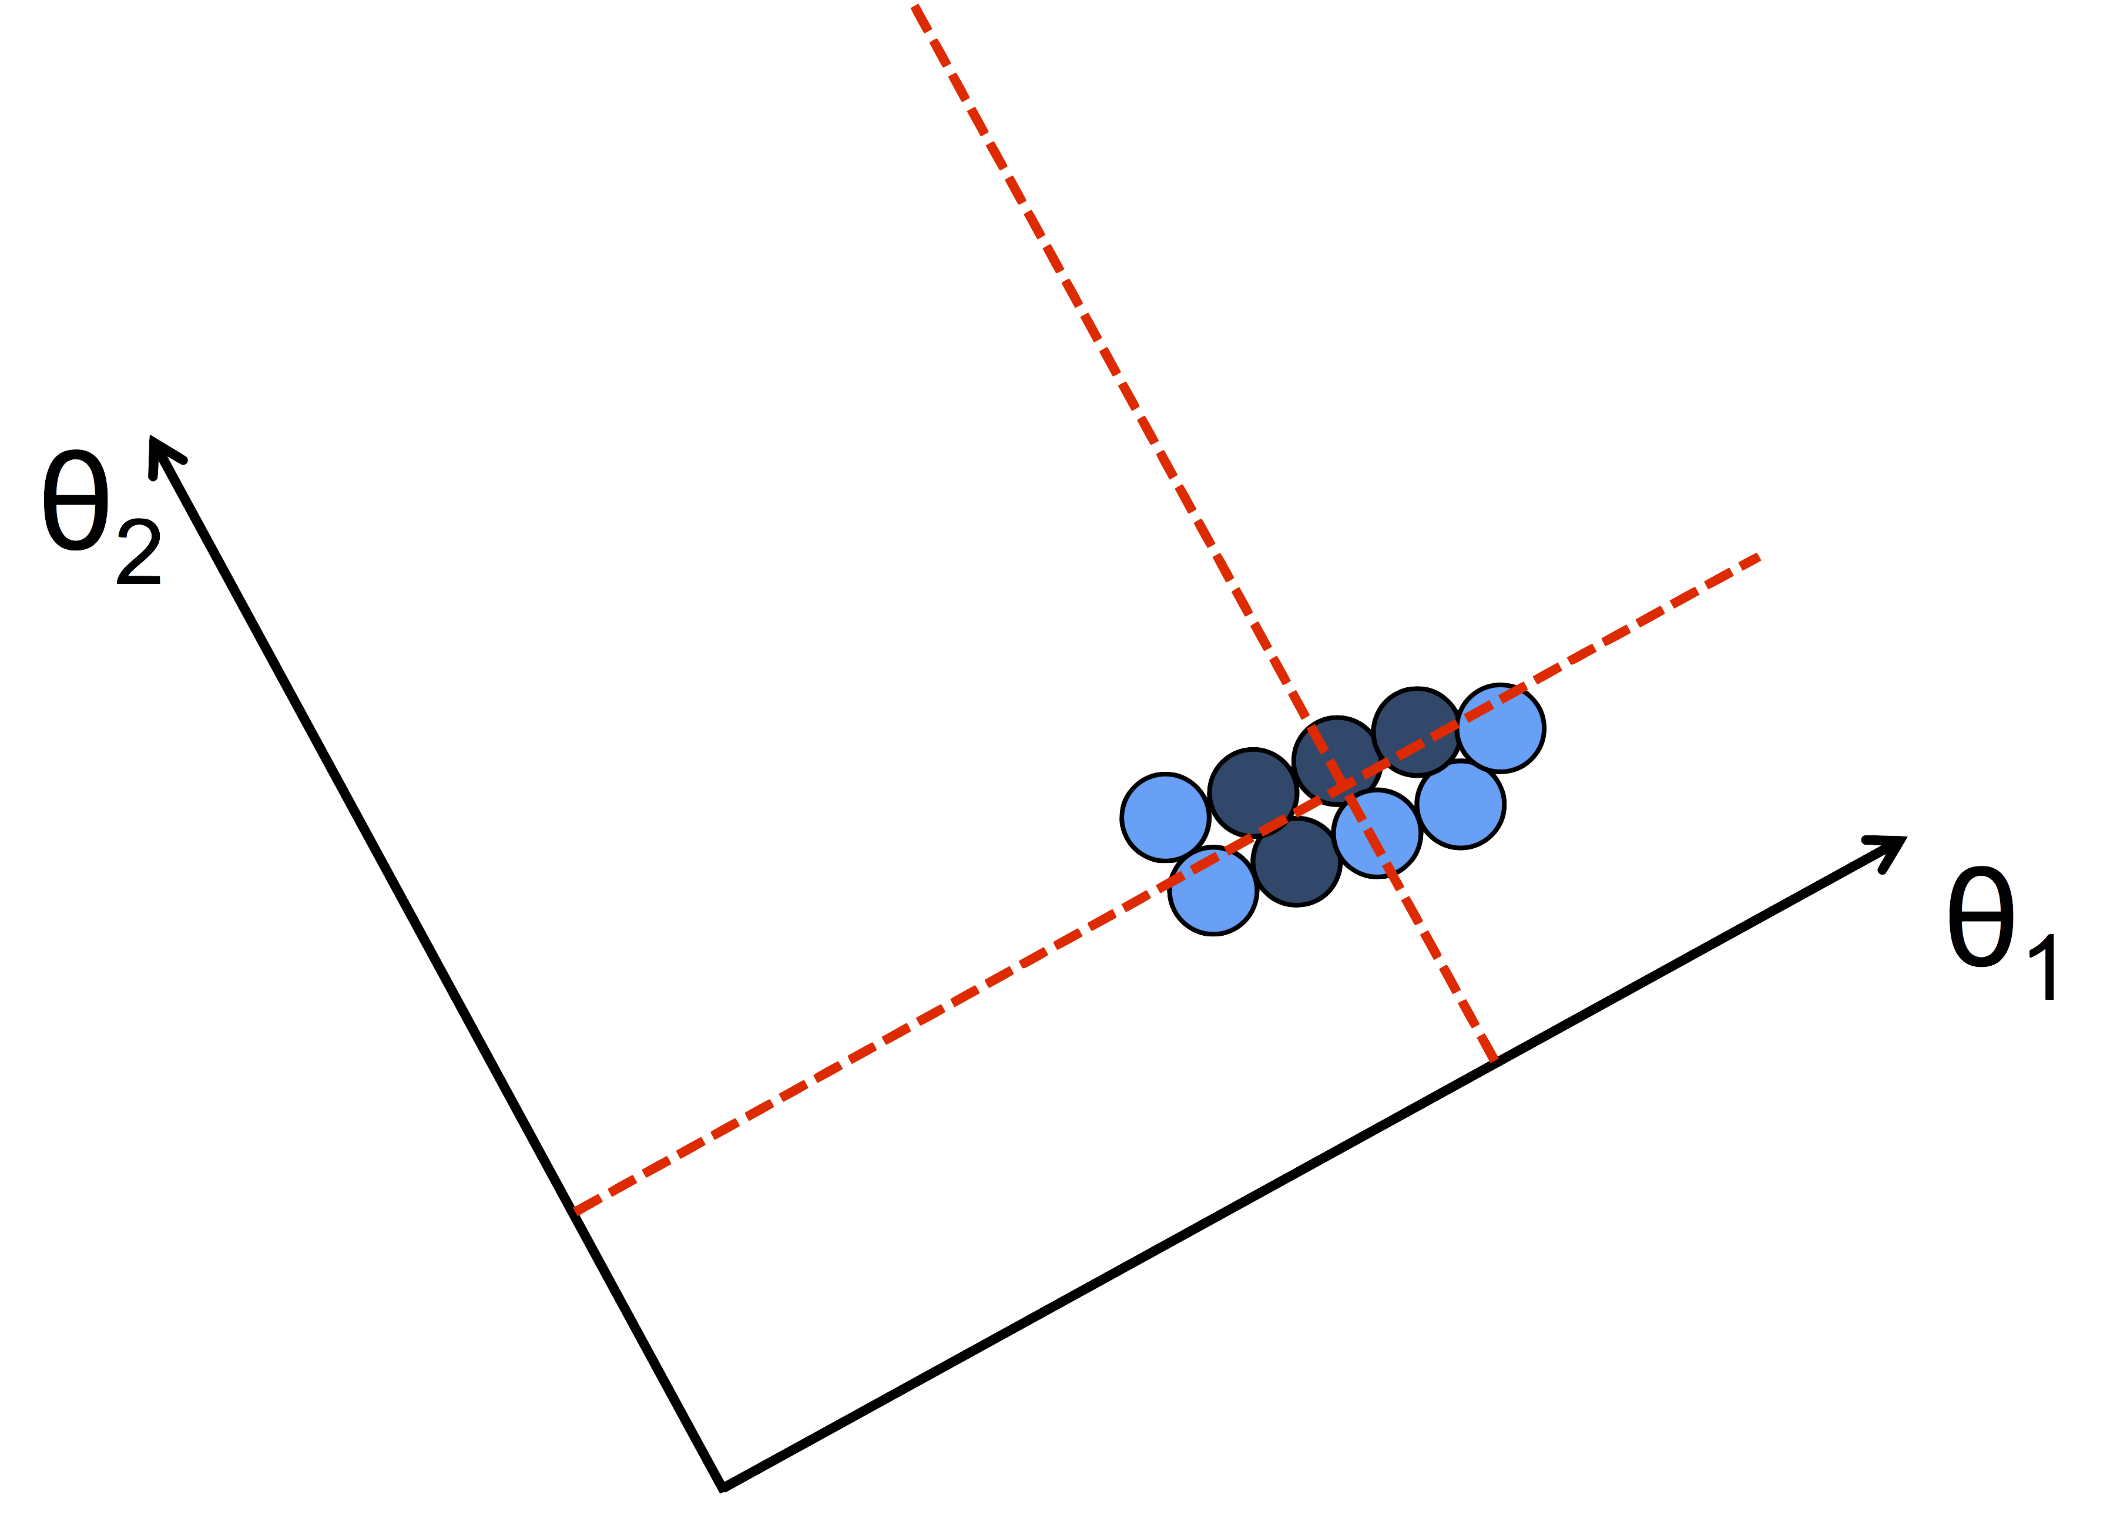
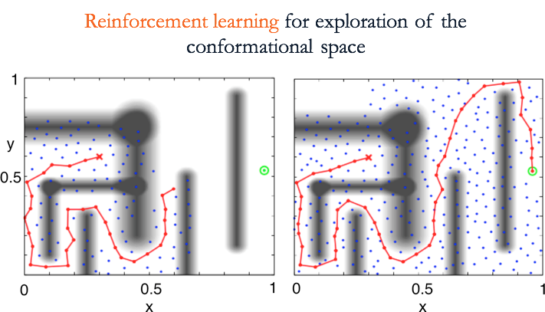
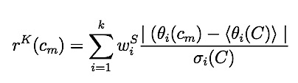
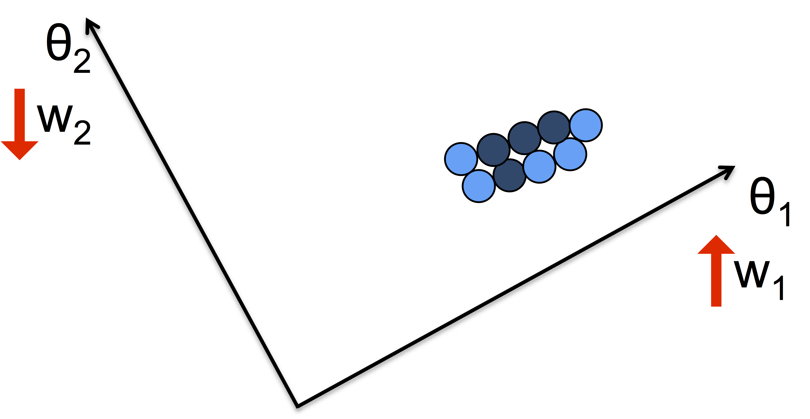
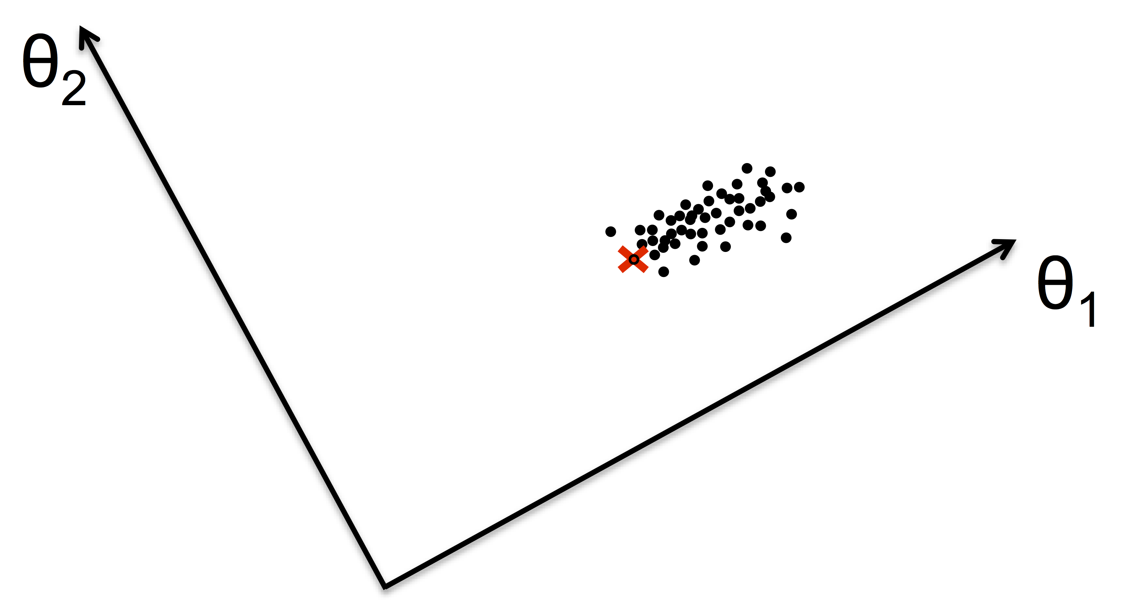
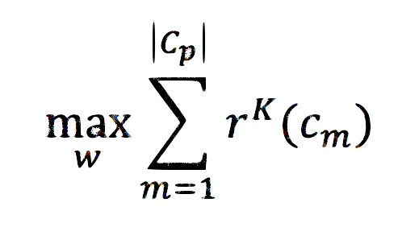
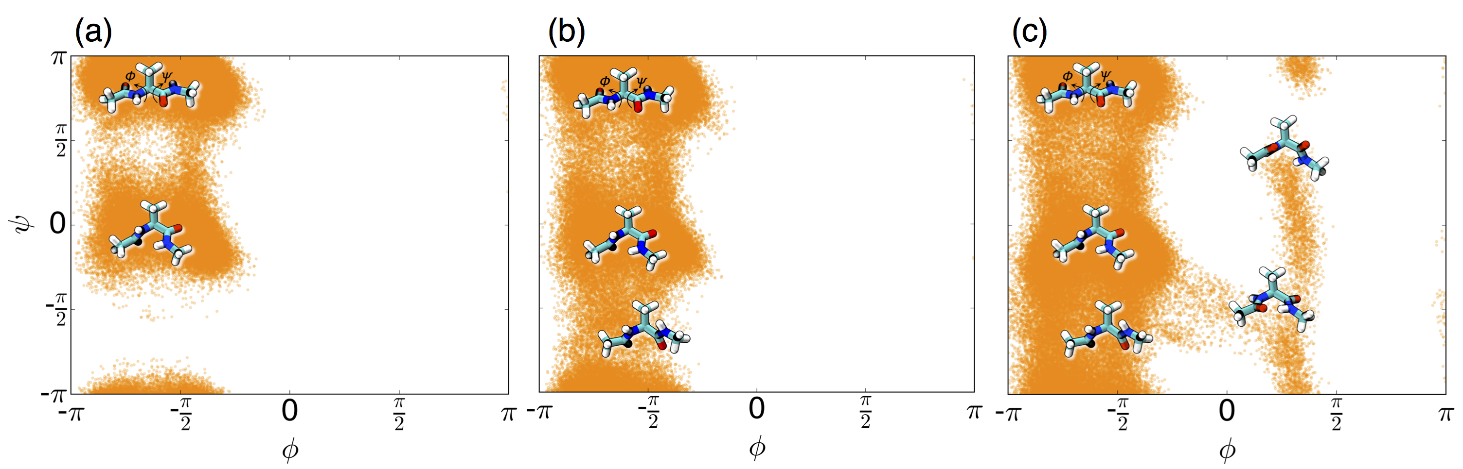
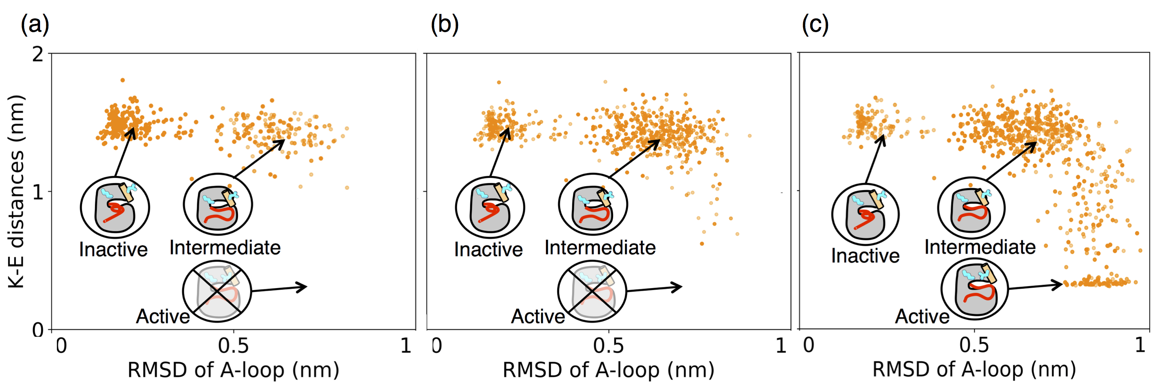
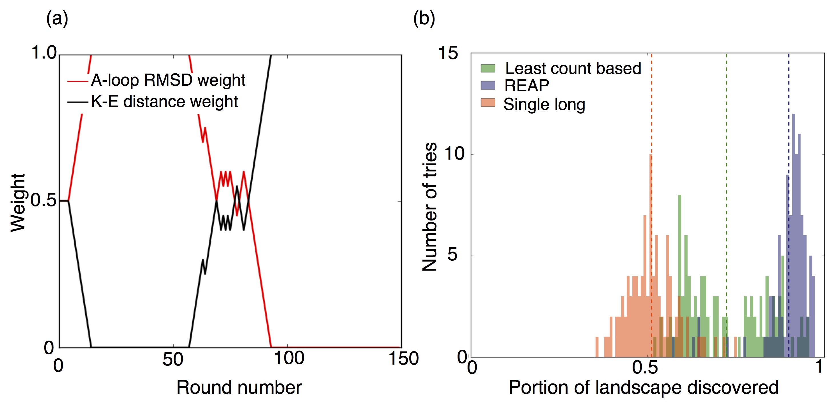
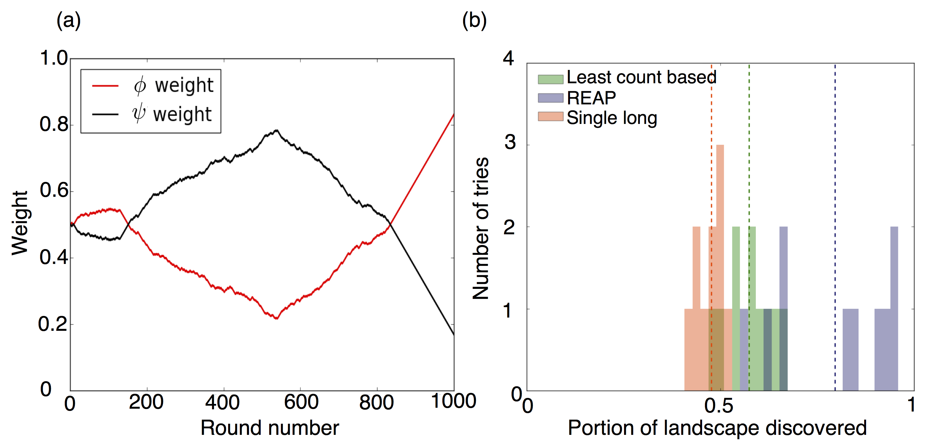
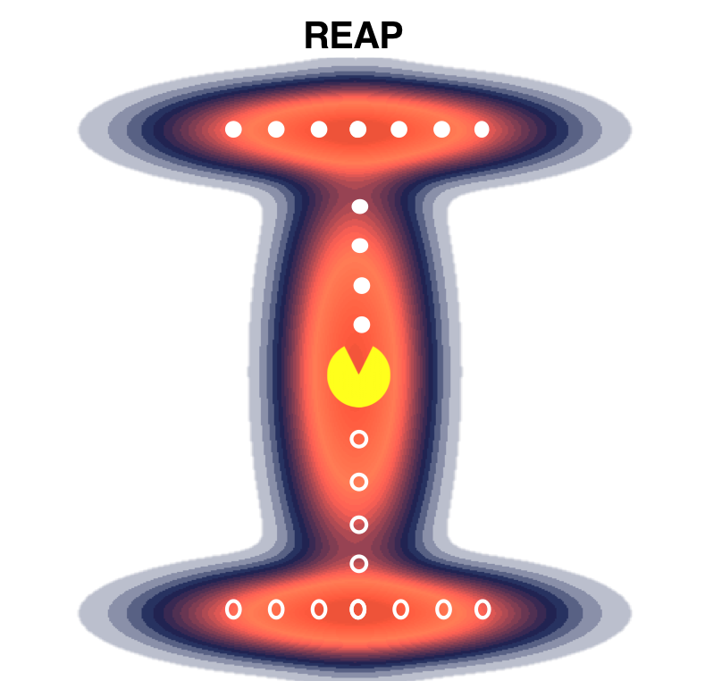
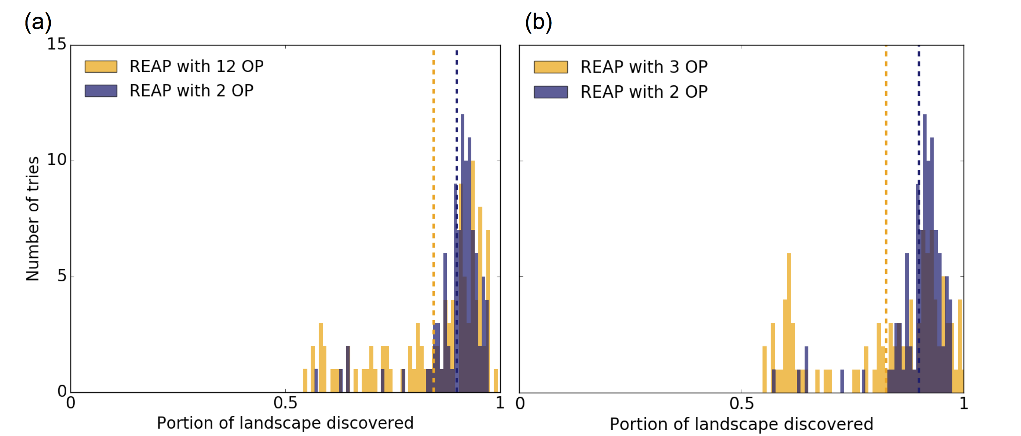

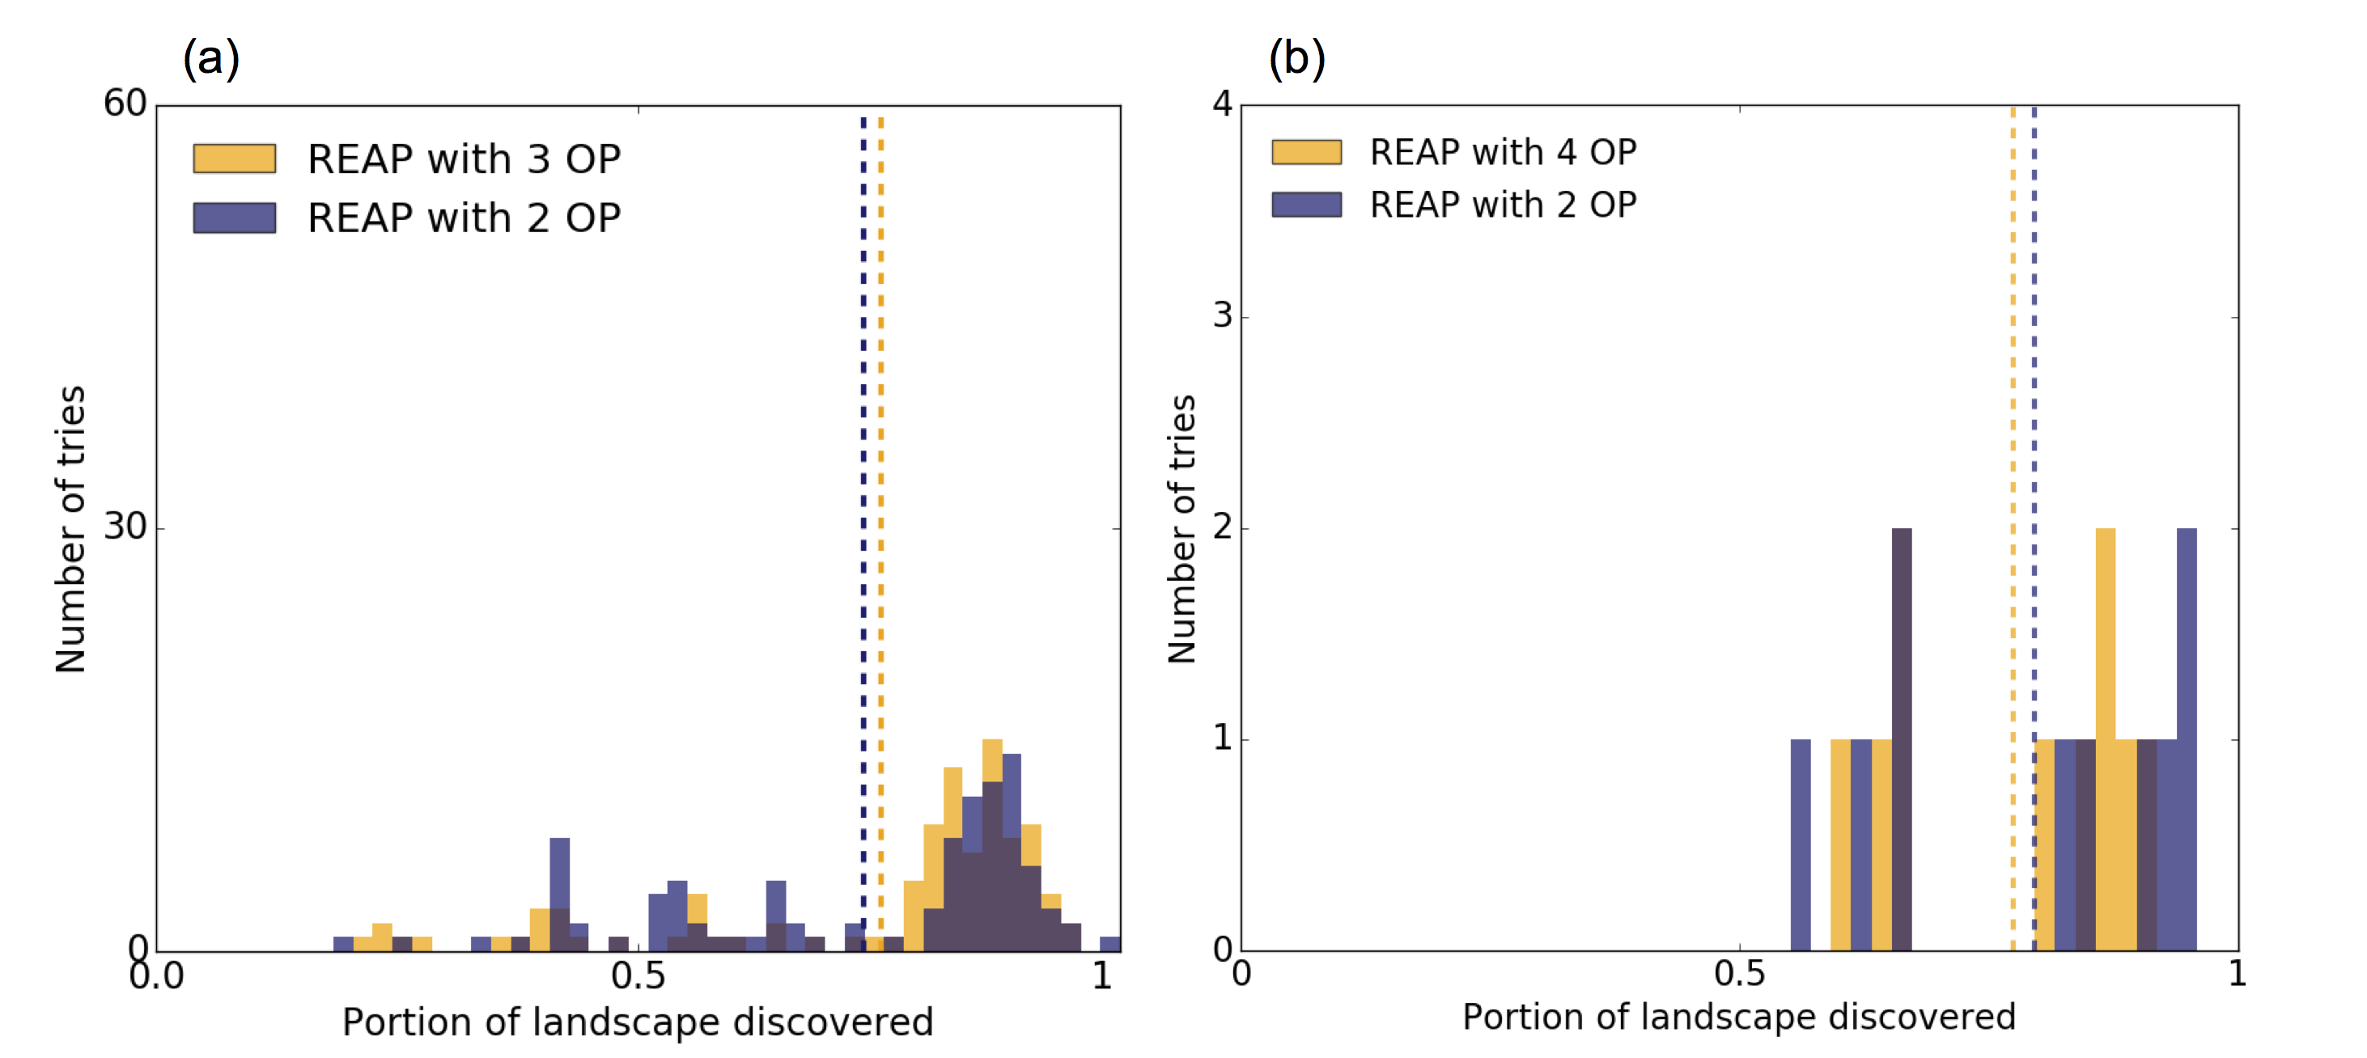
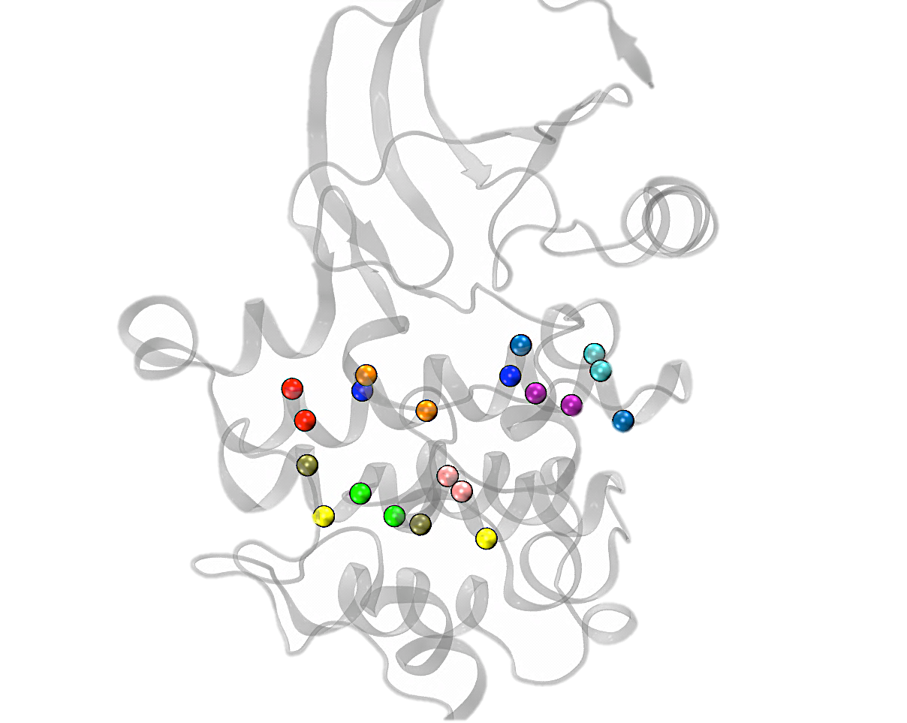



Efficient unbiased sampling of protein dynamics using reinforcement learning
Zahra Shamsi¹, Kevin J. Cheng², and Diwakar Shukla^{1,2}
¹Department of Chemical and Biomolecular Engineering, ² Center for Biophysics and Quantitative Biology, University of Illinois at Urbana-Champaign
Email: diwakar.shukla@shuklagroup.org
It is challenging to sample rare events via simulations.
Molecular dynamics (MD) simulations capture the atomistic details of the motions of atoms. We need powerful computational resources to gain mechanistic insights of the proteins.
What is REinforcement learning based AdaPtive sampling?
REAP Algorithm
REAP the rewards using Reinforcement Learning.
As one reaction coordinate is important for sampling, the other becomes less relevant.
(1)
Set the weight w_{i} for each θ_{i}
(2)
Run short simulations
Network of Protein Conformations
(3)
Cluster the data and find least counts
Calculate the reward
(4)
Free Energy Landscape
Shukla et al., Acc. Chem. Res, 2009
REAP (REinforcement learning based Adaptive samPling) is “smart” enough to determine the importance of each order parameter (OP) as it explores the landscape and rewards sampling along important OP and disregards others that do not facilitate exploration or exploitation.
1
0.5
0
The main challenges in molecular dynamics simulations are simulation timescale and accuracy.
Fast conformational
change
Slow conformational
change
(5)
Update the weights
(6)
Bond
vibration
Water
dynamics
Helix
forms
y
Pick a new
starting point and go to (2)
10⁻¹⁵
10⁻¹²
10⁻⁹
10⁻⁶
10⁻³
10⁰
second
0 0.5 1
0 0.5 1
MD step
Long MD
x
x
How effective is REAP?
Conclusion
Conformational sampling: Alanine dipeptide
Enzyme activity: Src kinase activation
We furthermore demonstrated that the REAP algorithm’s effectiveness in a protein system that has implications in cancer drug discovery. Total of 15 μs Monte Carlo simulations on MSM of Src kinase using SL, LC, and REAP were performed.
The proposed algorithm, REAP, has been shown to efficiently sample landscapes. It achieves this by identifying which RCs maximizes a reward function that encourages exploratory behavior. In all systems that were studied, REAP consistently outperformed the traditional simulation approach and least count based sampling when examining the distribution landscape discovered for the same simulation time.
Total of 2 ns MD simulation of Alanine dipeptide using SL, LC, and REAP were performed. REAP samples the dihedral angle landscape more effectively in the same amount of simulation time.
π
Single Long
(SL)
Least Count
(LC)
REAP
2
0
Single Long
Least Count
REAP
15
10
5
0
LC
REAP
SL
-π/2
4
0
LC
REAP
SL
K-E distances (nm)
Number of tries
Ψ
0
# Tries
Shamsi, Z., Cheng, J. K., & Shukla, D. REinforcement learning based Adaptive samPling: REAPing Rewards by Exploring Protein Conformational Landscapes, arXiv:1710.00495, 2017.
-π/2
0 1
-π
Discovered portion
-π -π/2 0 π/2 π
-π -π/2 0 π/2 π
-π -π/2 0 π/2 π
0 0.5 1
0 0.5 1
0 0.5 1
0 0.5 1
Φ
Φ
1
0.5
0
Φ
A-loop RMSD (nm)
A-loop RMSD (nm)
A-loop RMSD (nm)
Discovered portion
The algorithm initially starts from φ direction, but quickly learns that ψ is the best to sample along
Φ weight
Ψ weight
1
0.5
0
A-loop RMSD weight
K-E distance weight
REAP initially finds sampling along the A-loop RMSD more important than K-E distance. Afterwards, the weights fluctuate until the K-E distance then becomes relevant for sampling.
Acknowledgements
4
2
0
4 OPs
2 OPs
15
10
5
0
12 OPs
2 OPs
0 500 1000
0 150
Number of tries
Round number
Round number
Number of tries
Performance of REAP using two extra OPs, θ, and ζ. Much like the results with the L landscape, sampling of 4 OPs is comparable with 2 OPs.
Comparable result was achieved by providing 10 insignificant distances situated on the αE and αF helix (12 OPs total).
0 0.5 1
0 0.5 1
Discovered portion
Discovered portion

